Slide 1

CRM for BMW
By
Group 8
Mr.Pongraphe Kangsanarak
Ms.Simon Tanquerido Pricilla Faye
Mr.Issaret Prachitmutita
Mr.Nguyen Thai Anh
Mr.Abhinav Asheesh Lugun

Slide 2
Agenda
Project description
Business Rules
Conceptual Diagram
Logical Diagram
Our own SQL

Slide 3
Project description
Our goal in creating a customer relationship management system (CRM) for the BMW showroom is to digitally transform the business by concentrating on the two areas of management, and maintenance. Such as
Dashboard for executive
Sale statistics
Purchase and repair history
Repair Performance
Management system for maintenance team.
Accident History
Repair History
Spair parts inventory
Mechanic Team
Customer History
Purchase Order Transaction
Vehicle History
Warranty tracking

Slide 4
Business Rules
In each of purchase order, our business only order one part number per model.
Each repair job has estimated time for repair tasks completion.
Warranty will cover only the spare part separately.
Customer can track the current repair status of his/her vehicle
Each repair job can have many repair detail
Each repair detail represent repair part. lists a vehicle part added and its cost, cost of service, description of repair, mechanics working on it, and the current repair status
Repair job is completed when all its separate repair detail takes are also completed

Slide 5
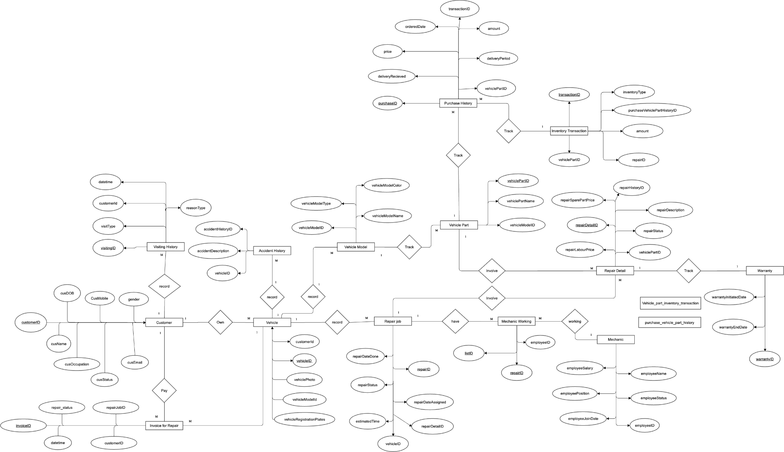
Conceptual Diagram

Slide 6
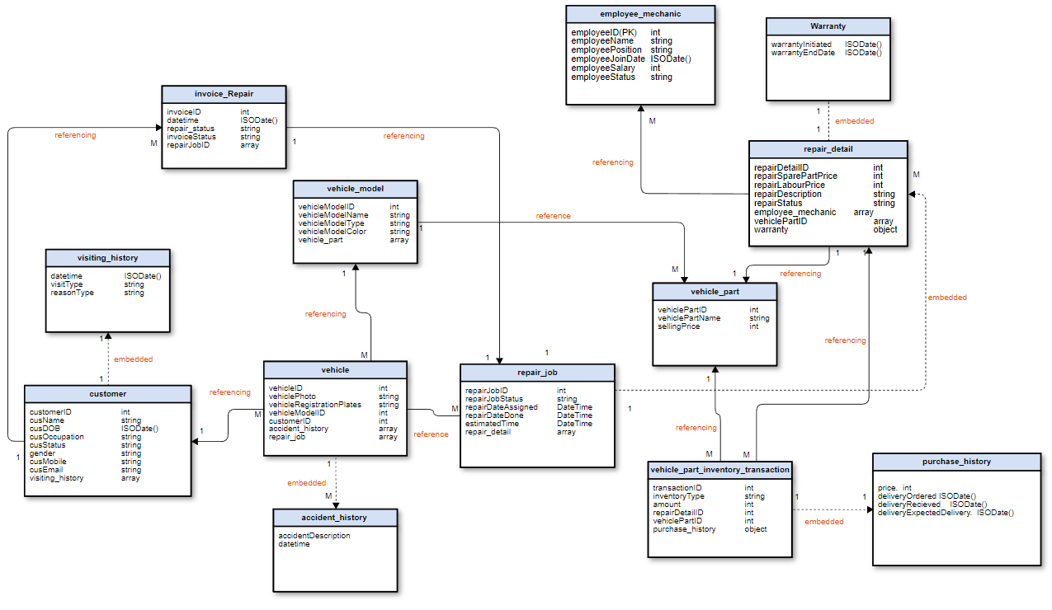
Logical Diagram

Slide 7
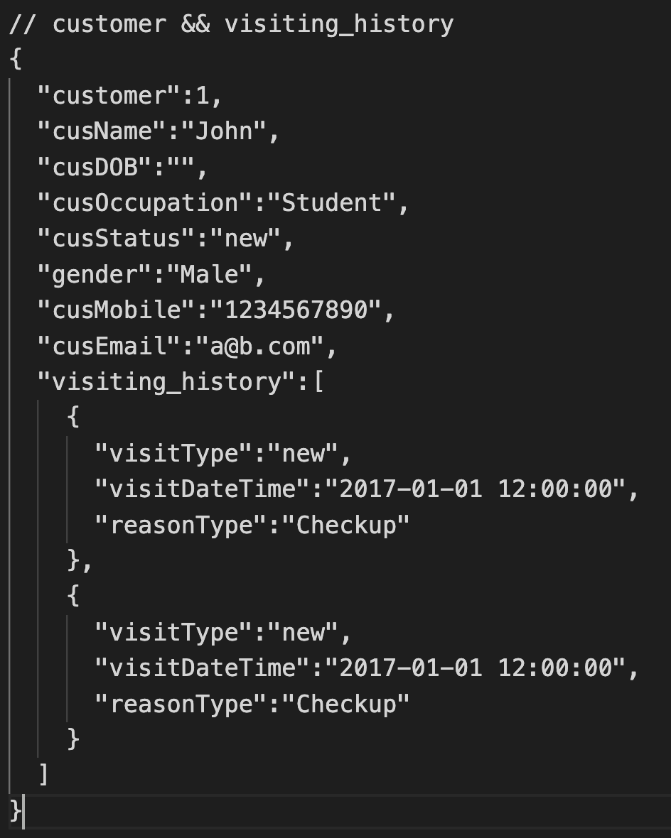
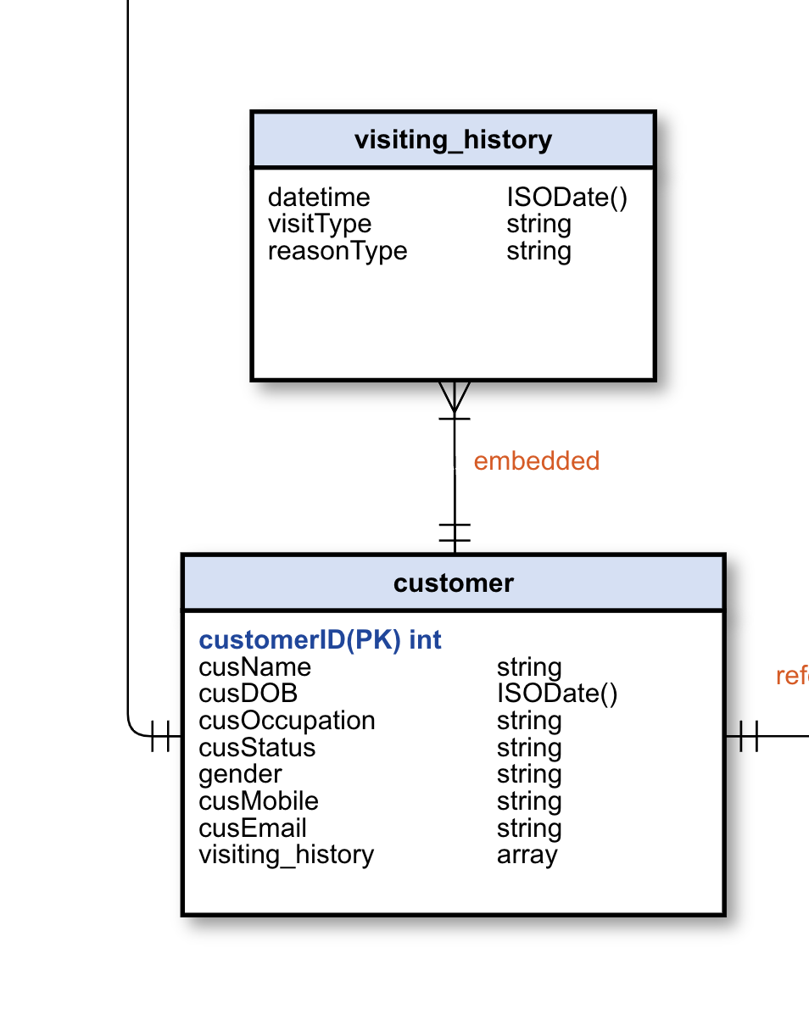
Data; customer & visiting history

Slide 8
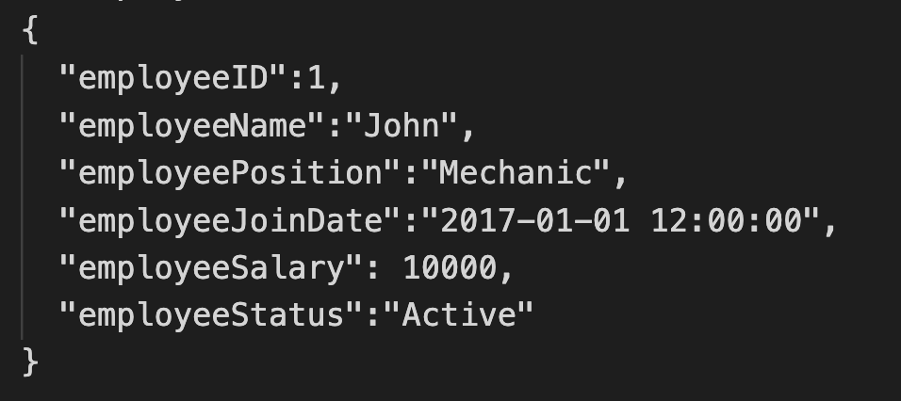
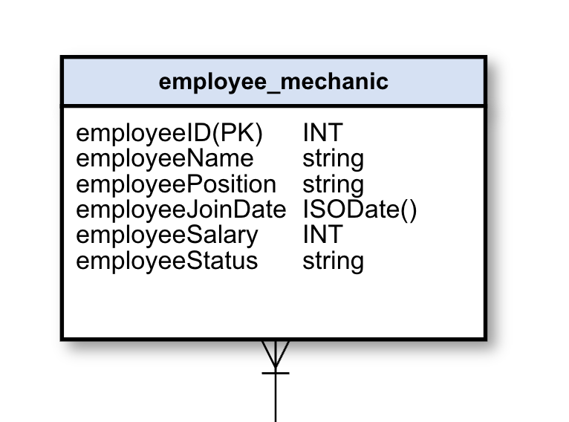
Data; employee_mechanic

Slide 9
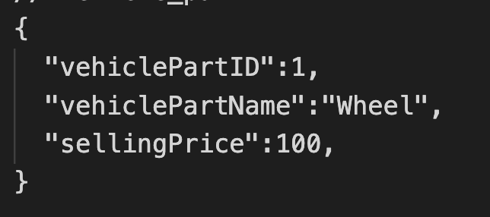
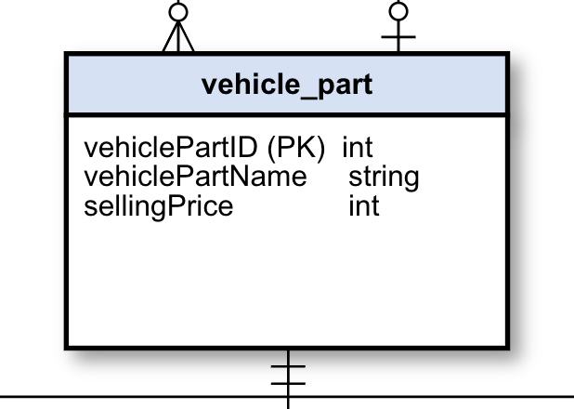
Data; vehicle_part

Slide 10
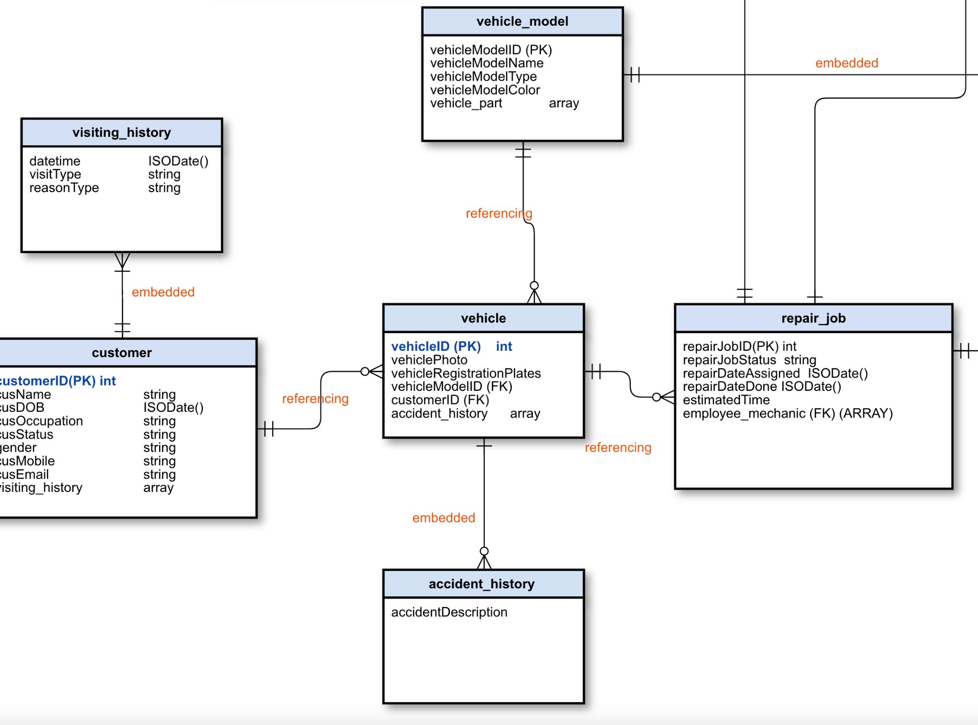
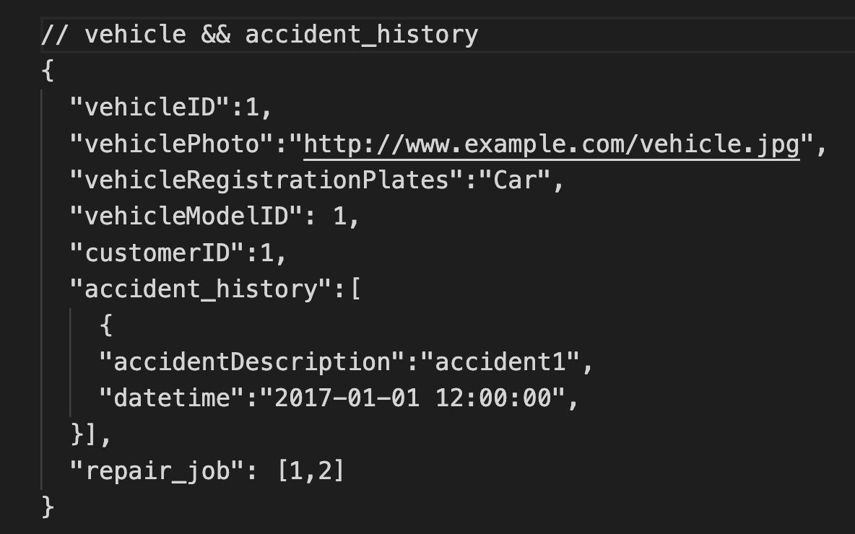
Data; vehicle && accident_history

Slide 11
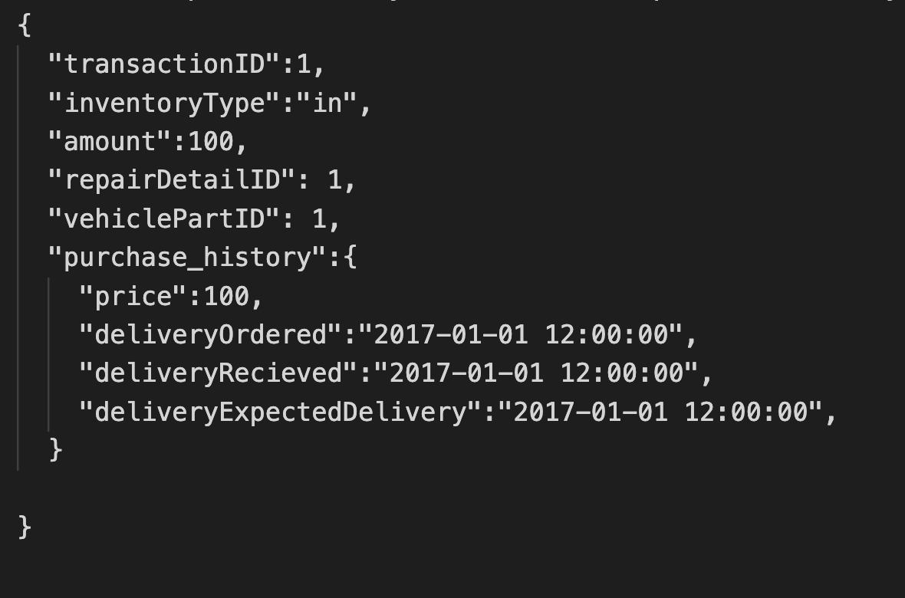
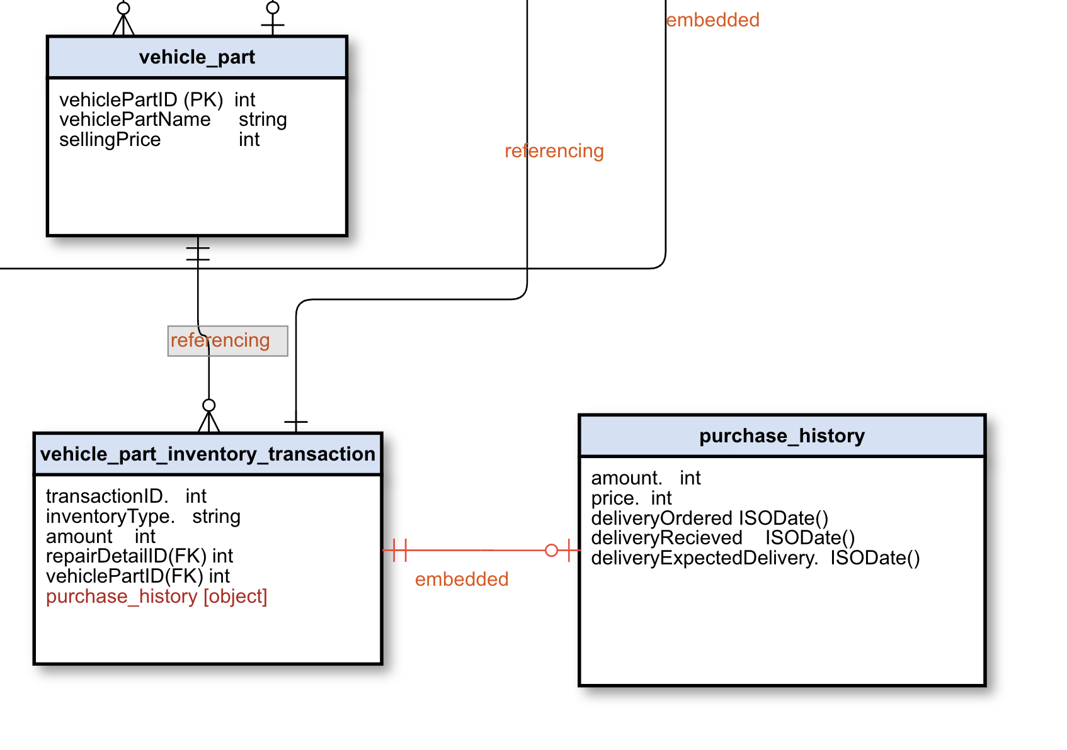
Data; vehicle_part_inventory_transaction && purchase_history

Slide 12
Issaret
Notes:
Since the database was designed for this business case, SQL query can be very simple.

Slide 13
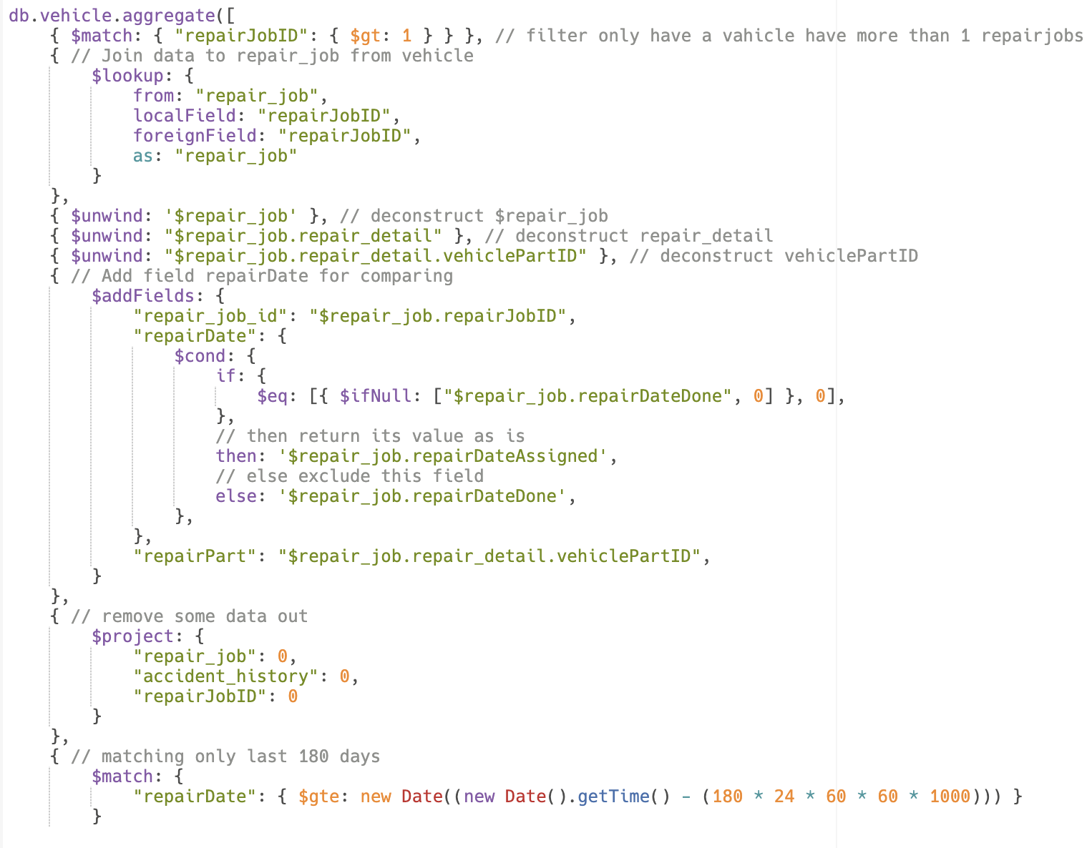
Select to find which car have more than 2 repair jobs for repair the same details in last 180 days?

Slide 14
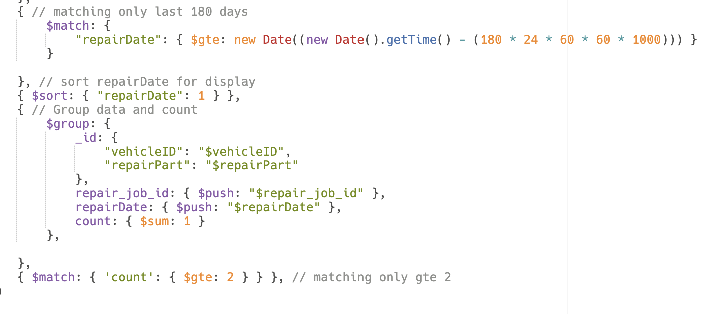
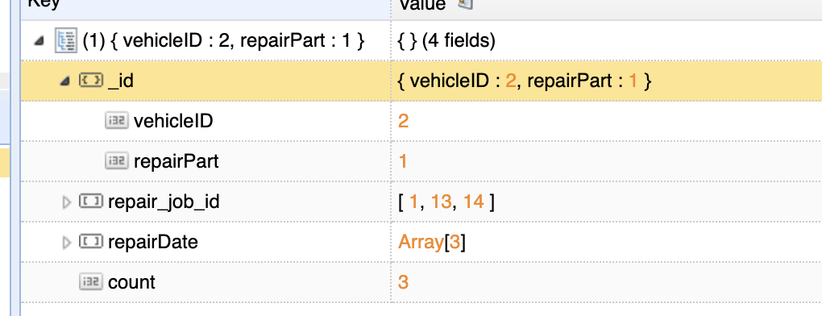

Slide 15
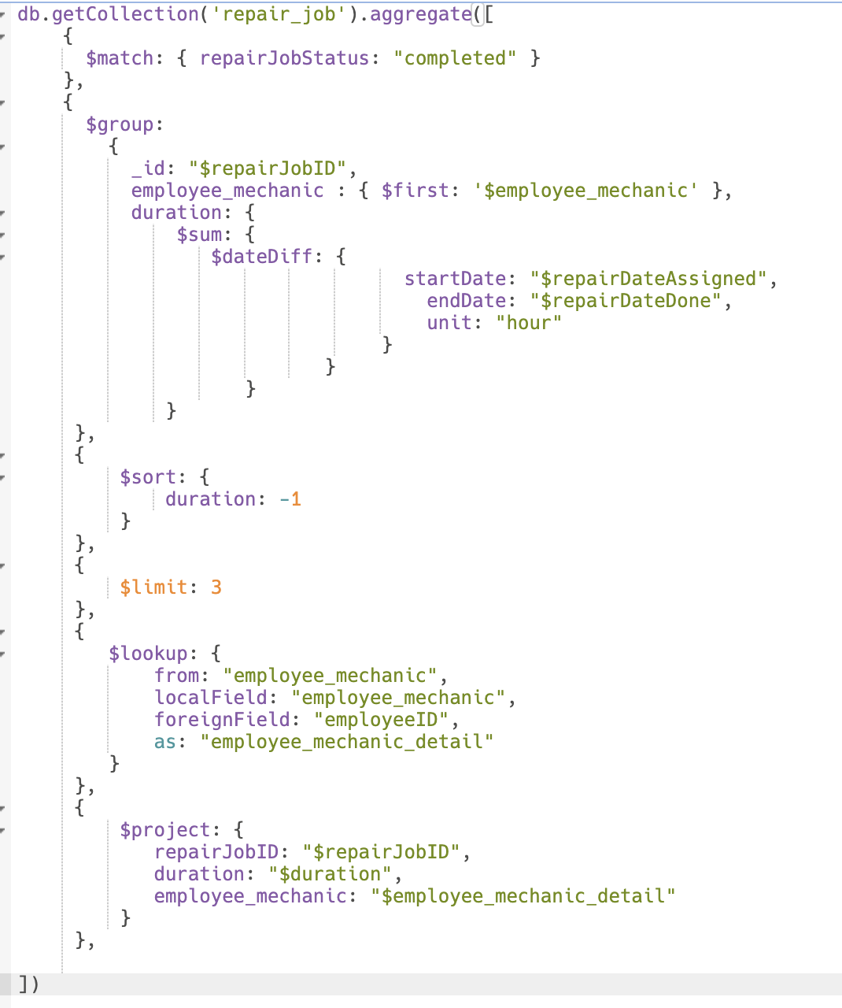
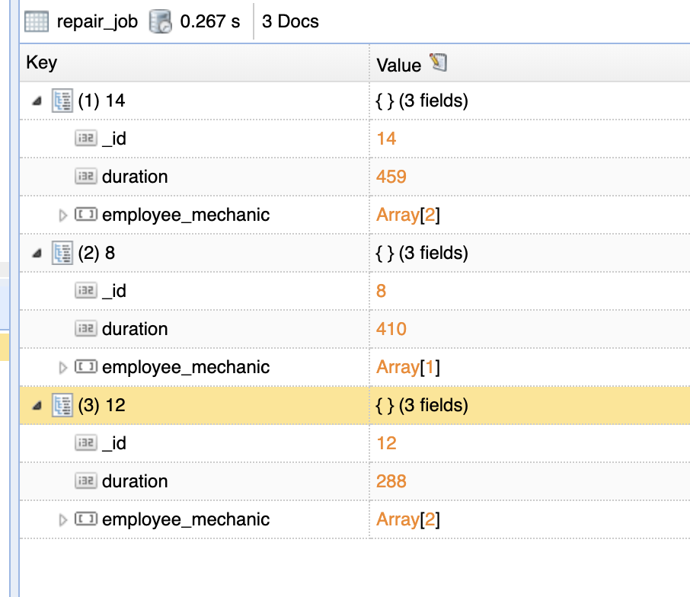
Find the top 3 job that was repaired
as quickly as possible and by whom?

Slide 16
Issaret
The executive would like to have a dashboard for his business
Steps:
which car model is the most profitable for spare parts margin in average ?
In the last 3 months, which car model doesn't make much money at all?

Slide 17
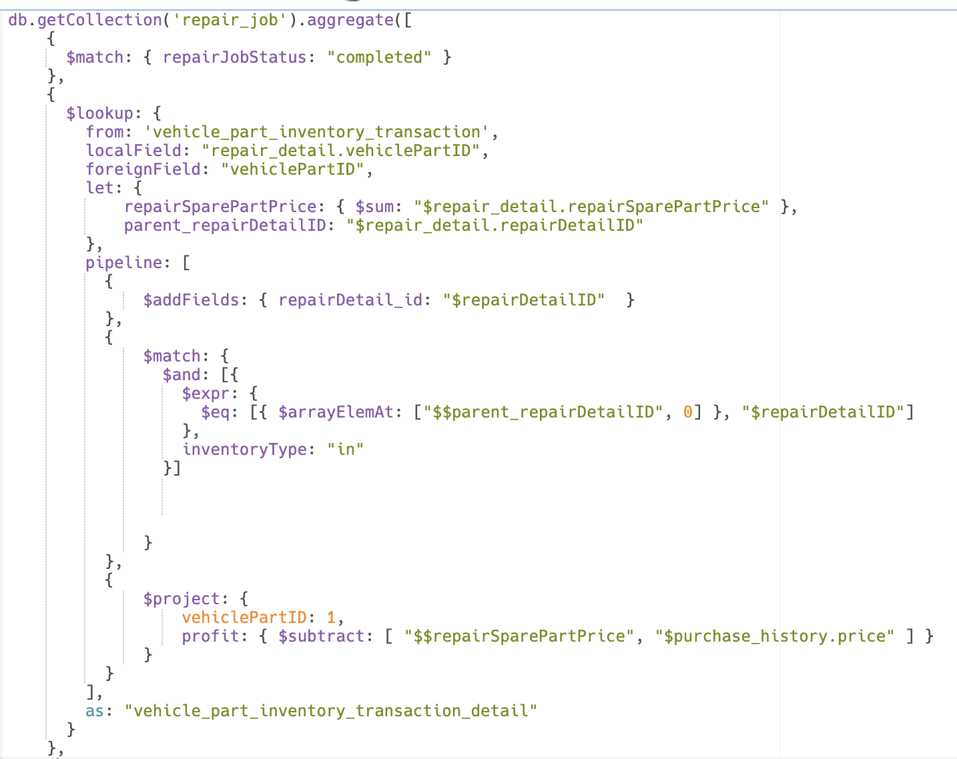
which car model is the most profitable for spare parts margin in average ?

Slide 18
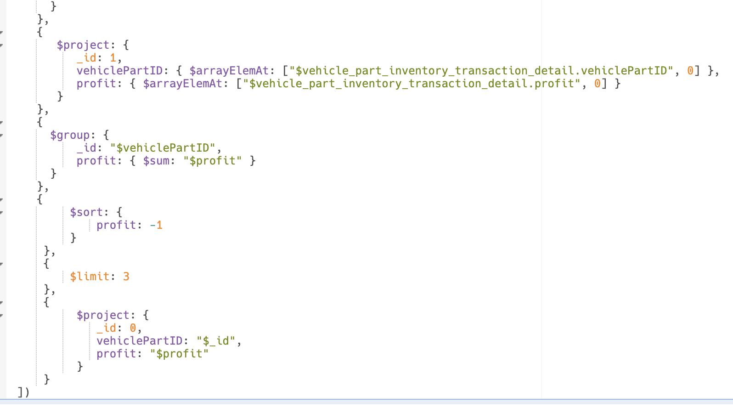
which car model is the most profitable for spare parts margin in average ?

Slide 19
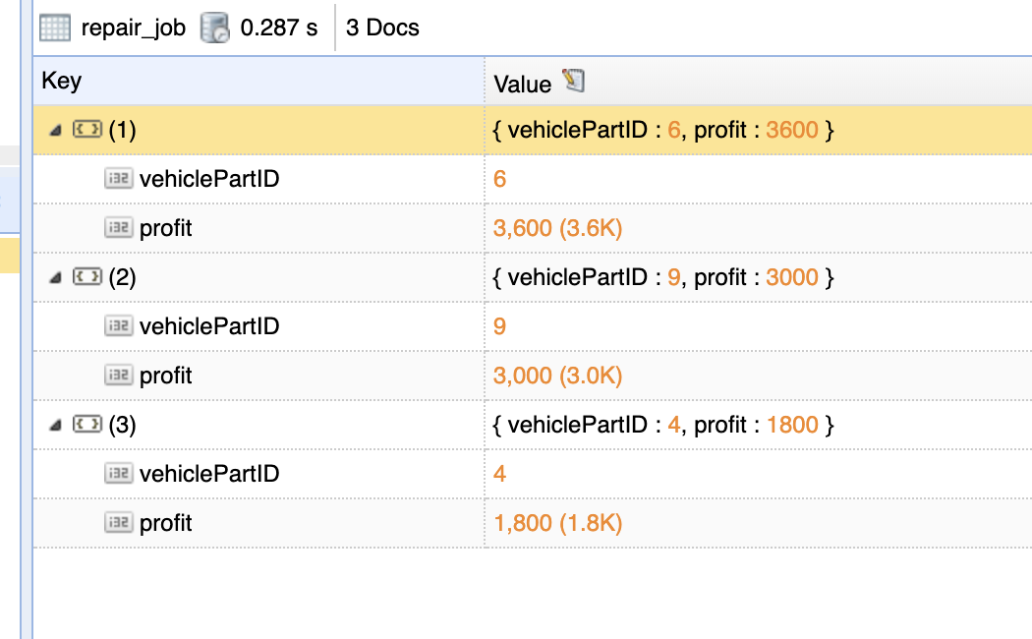
which car model is the most profitable for spare parts margin in average ?

Slide 20
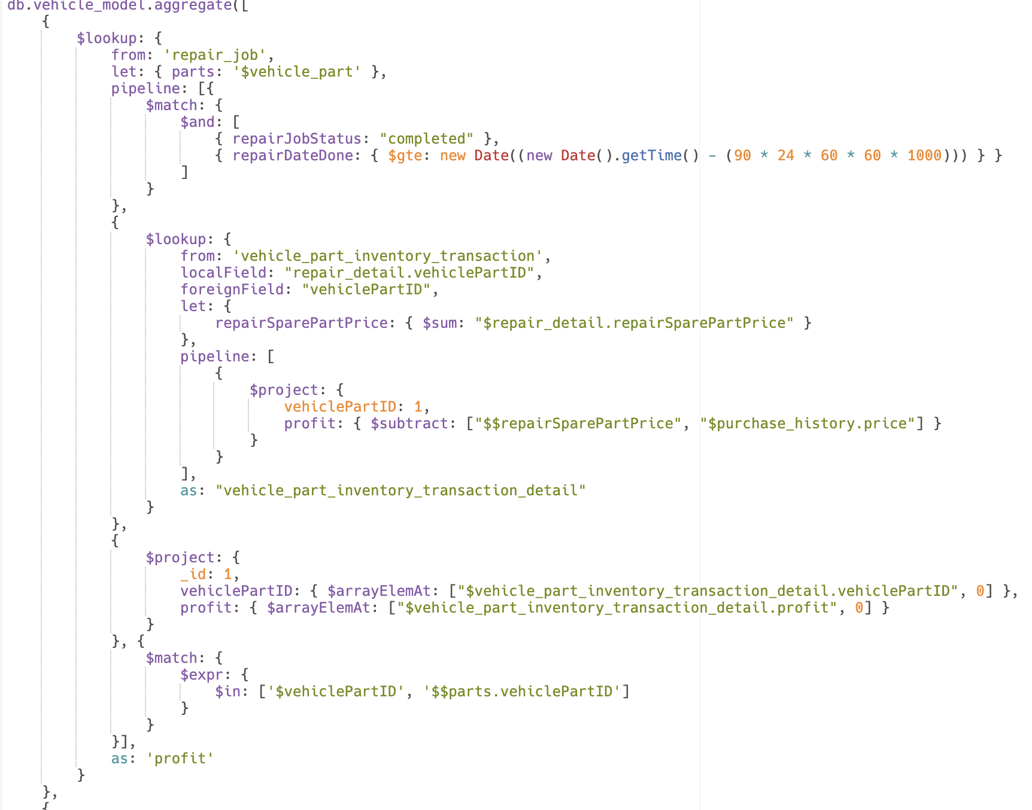
In the last 3 months, which car model doesn't make much money at all?

Slide 21
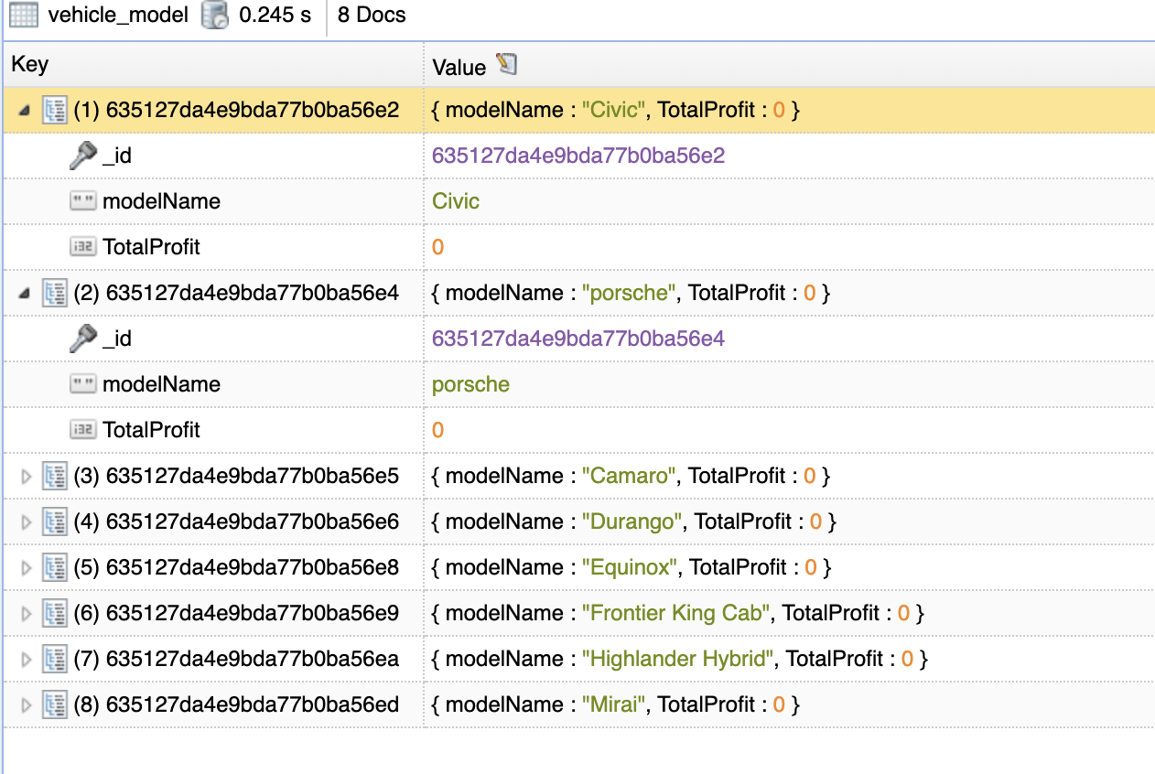
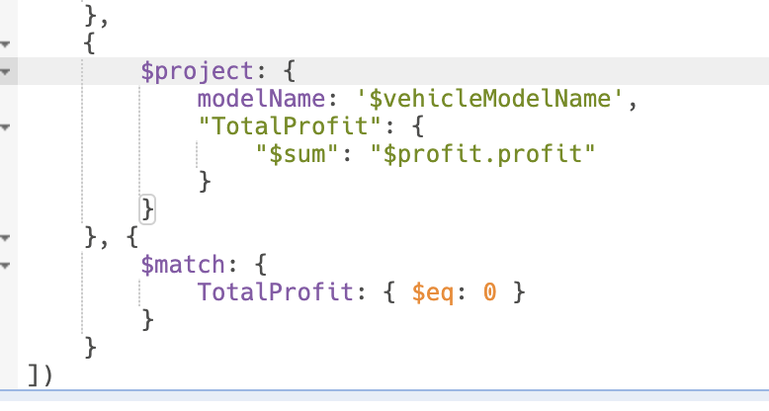
In the last 3 months, which car model doesn't make money at all?

Slide 22
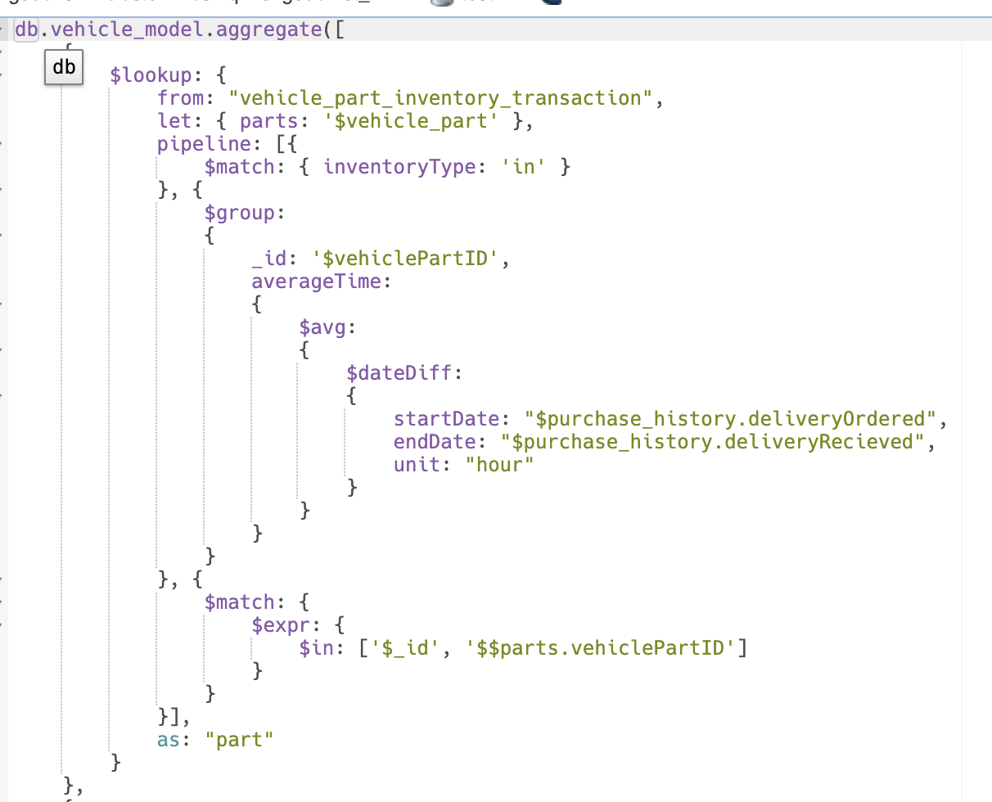
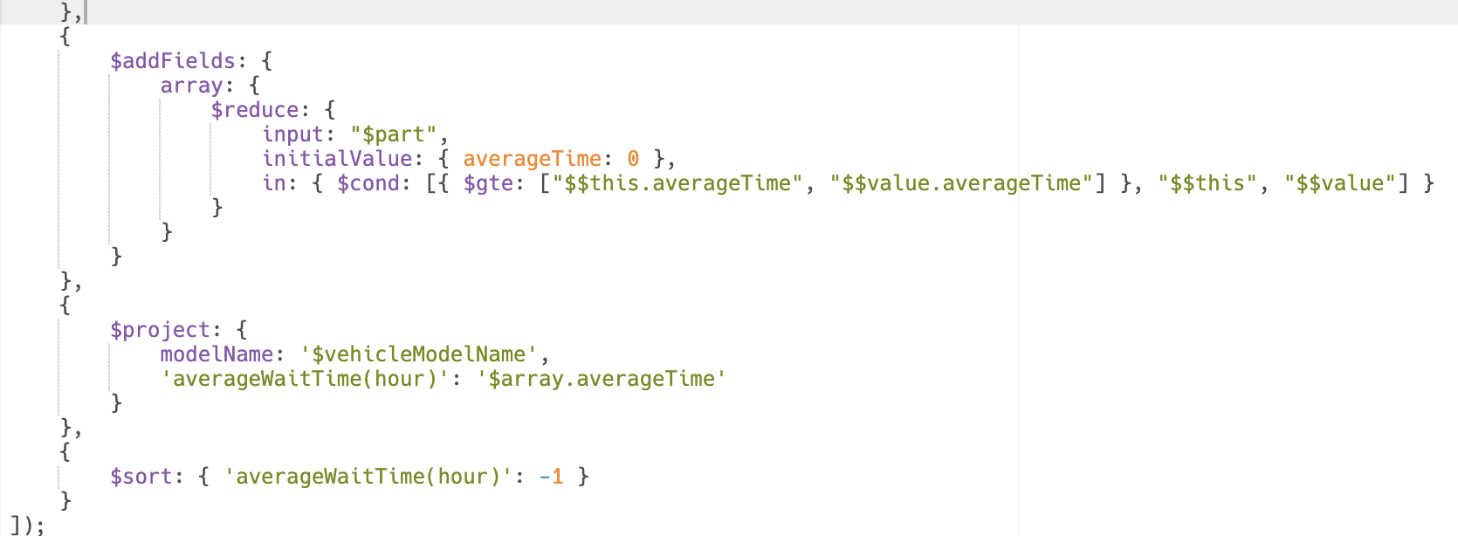
Issaret
The manager of inventory would like to report to his executive that which car model has the longest wait for parts?

Slide 23
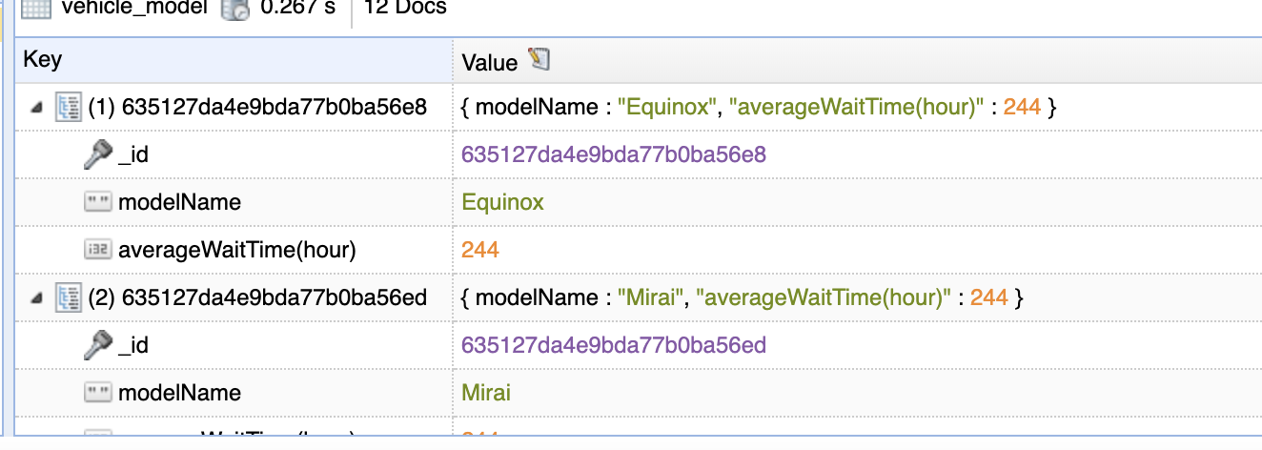
Issaret
The manager of inventory would like to report to his executive that which car model has the longest wait for parts?

Slide 24
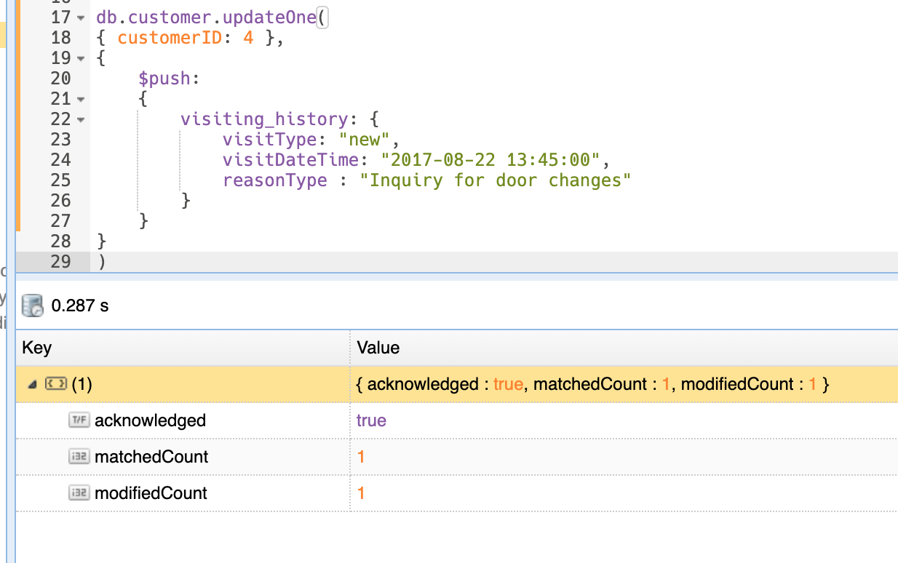
Issaret
The staff welcomes customers who visit and advises the prices of their car repairs. Some people may ask the price and use the service. Some people may not use the service.
Steps:

Slide 25
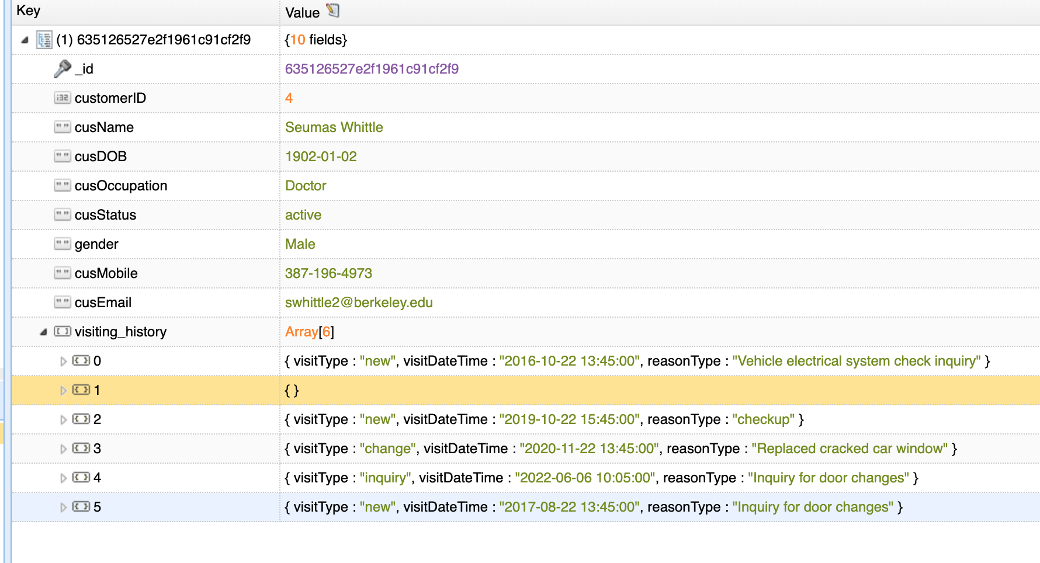
Issaret
The staff welcomes customers who visit and advises the prices of their car repairs. Some people may ask the price and use the service. Some people may not use the service.

Slide 26
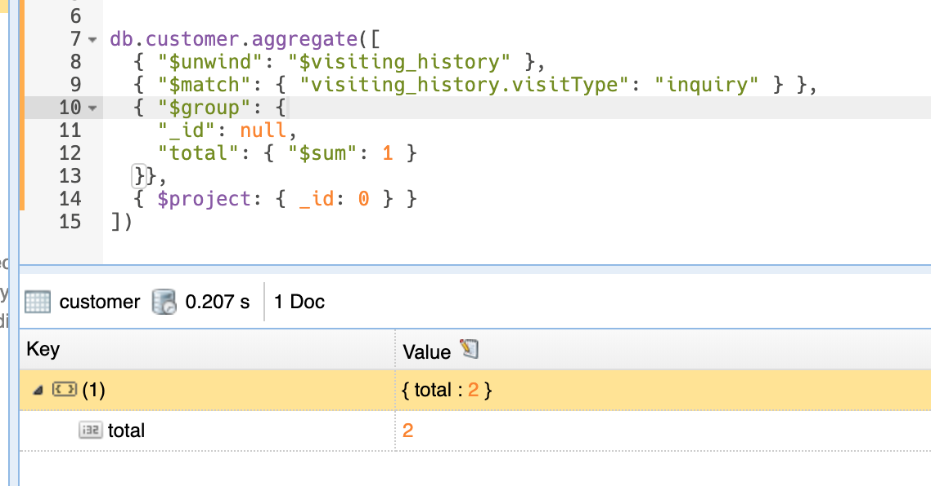
The manager would like to know how many client came to the shop and not repair?

Slide 27
AOF
Scenario: Customer want to know the repair prices
Background: A new customer wants to register with the shop and manager want to know price and number of invoice
Addressed question:
1. Check the the customer, old or new, using full name and insert their infor eg. visites and customer’s info .
2. Insert vehicle and customer information
3. Manager want to know on how many incomplete and complete invoice.
4. Manager want to know the most expensive labour
5. Manager want to know the most expensive spare price that in complete status

Slide 28
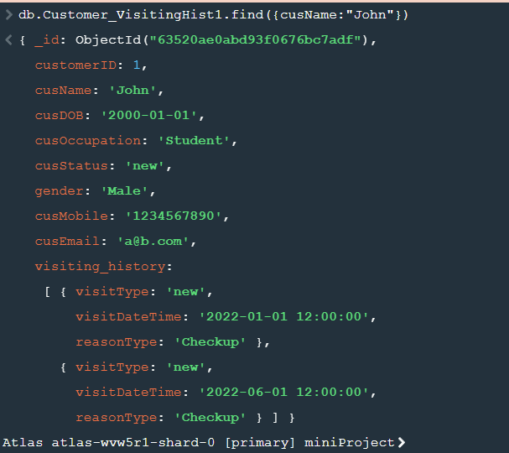
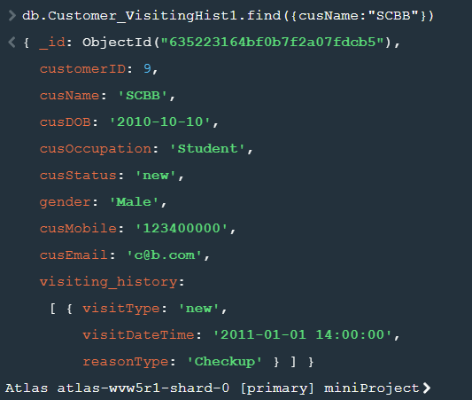
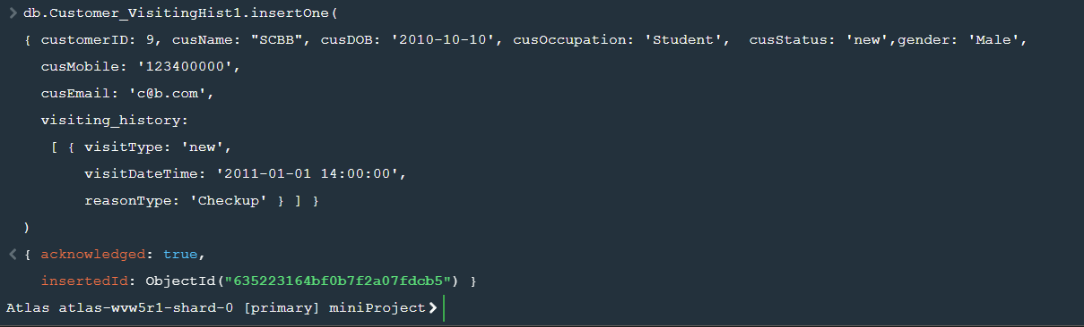
Check the the customer, old or new, using full name and insert their infor eg. visites and customer’s info .

Slide 29
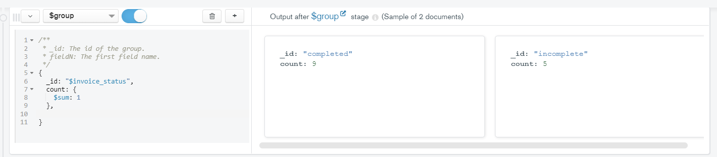
Manager want to know on how many incomplete and complete invoice.

Slide 30
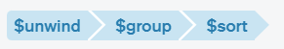
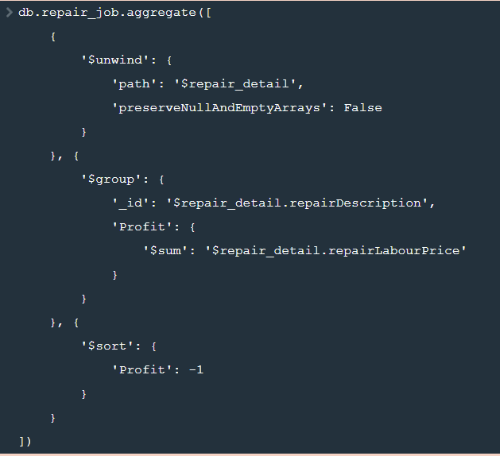
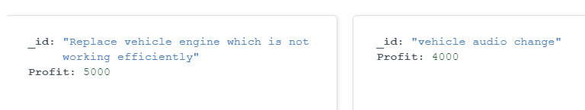
Manager want to know the most expensive labour

Slide 31
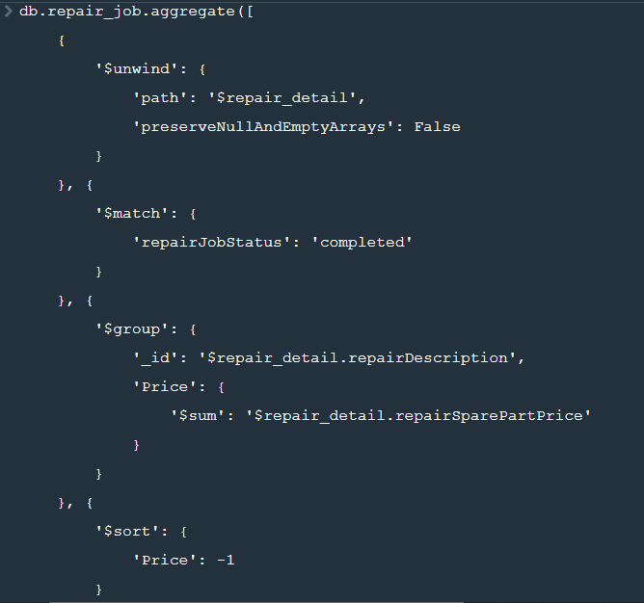
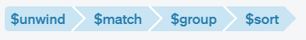
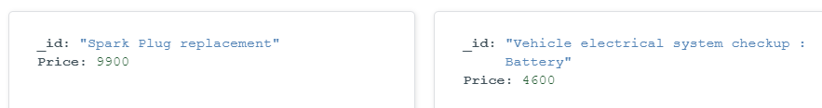
Manager want to know the most expensive spare price that in complete status

Slide 32
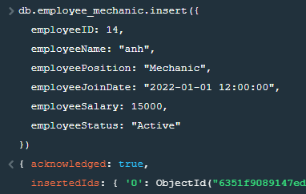
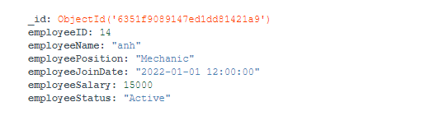
Anh
The HR manager of the company would like to add the details of a new employee.
Query:
Result:

Slide 33
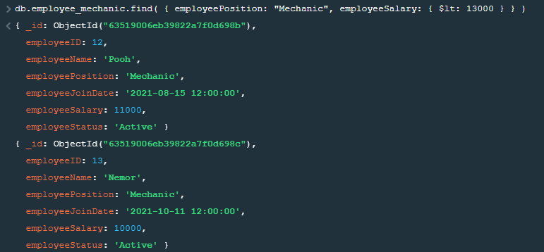
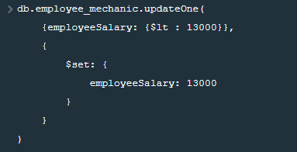
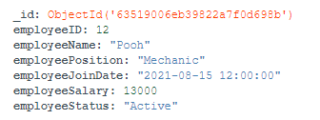
2. Assuming the country suffers from high inflation, the basic salary of the society is 13000 baht, so the manager wants to find people whose salary is below 13000 to raise them above the basic salary.
Query and Result

Slide 34
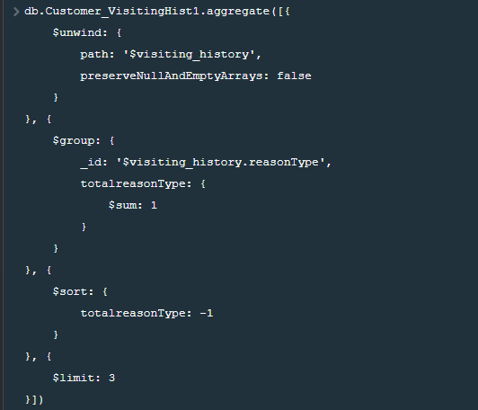
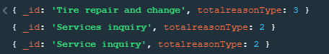
3. The procurement team would like to know what is the most common services availed by the customers. This information will help them know what equipment and materials to buy for the next fiscal year.
Query:
Result:

Slide 35
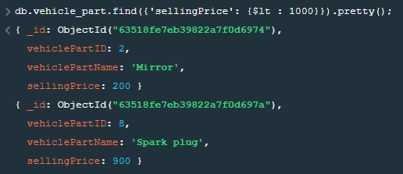
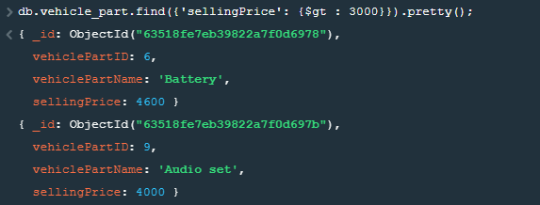
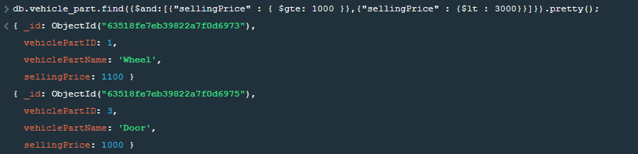
4. On the company’s anniversary, the marketing team would like to give discounts to their items to show their thanks to all their customers. The team would like to find the different vehice part of prices of their existing equipment
Query and result

Slide 36
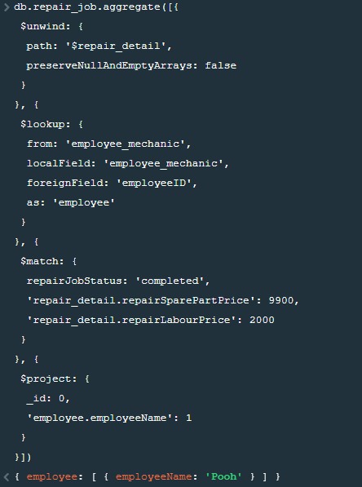
Query and result
5. One of the clients is complaining on the quality of repair of his BMW. He does not remember the name of the mechanic but he remembers that he paid 9,900 for the part and 2,000 for the labor. The company’s customer service would to do a check on who is this mechanic based upon the given information.

Slide 37
Abhinav
Scenarios:
A manager wishing to know which vehicle parts to order more
Customer seeing a detailed report of his/her vehicle repair

Slide 38
Scenario: Ordering Vehicle Parts
Description:
As the manager, I would like to know which vehicle parts to order more based on current repair demand
Questions to answer:
Which repair problems are most common?
Which vehicle spare parts are most used?

Slide 39


Scenario: Ordering Vehicle Parts (2)
Which repair problems are most common?
SQL Query Version:

Slide 40



Scenario: Ordering Vehicle Parts (3)
Which repair problems are most common?
MongoDb Query Version:

Slide 41




Scenario: Ordering Vehicle Parts (4)
Which vehicle spare parts are most used?
SQL Query Version
By total vehicle part:
By vehicle model:

Slide 42


Scenario: Ordering Vehicle Parts (5)
Which vehicle spare parts are most used?
MongoDB Query Version
By total vehicle part:

Slide 43


Scenario: Ordering Vehicle Parts (6)
Which vehicle spare parts are most used?
MongoDB Query Version
By vehicle model:

Slide 44
Scenario: Ordering Vehicle Parts (4)
Conclusion:
Order more vehicle parts for Frontier King Cab
Order more wheels to meet repair demand

Slide 45
Scenario: Report of Vehicle under Repair
Description:
As a customer, I want to get a detailed report of my vehicle(s) under repair
Customer:
(Previously for SQL Query) Liam Brooks with customerId = 3
Seumas Whittle with customerId = 4
Queries:
Report of vehicle with details of each repair task
Report of vehicle of total cost, estimated repair completion

Slide 46

Scenario: Report of Vehicle under Repair (2)
Report of vehicle with details of each repair task
SQL Query Version:

Slide 47

Scenario: Report of Vehicle under Repair (3)
Report of vehicle of total cost, estimated repair completion
SQL Query Version:

Slide 48




Scenario: Report of Vehicle under Repair (3)
MongoDB Query Version:

Slide 49
Faye
Scenarios:
The manager would like to raise the salary of one employee.
The marketing team would like to know how often does their customers visit the shop?
The procurement team would like to know how often does the different brand of cars visit the shop?

Slide 50

Jason, being one of the best employees in the company is poised to be given a promotion and a raise. The manager would like to update the database so that the HR department can prepare for the next payroll
Query:
db.employee_mechanic.updateOne(
{
employeeName: "John"
},
{
$set:{
employeePosition: "Manager",
employeeSalary: "30000"
}
}
)
Result:

Slide 51

2. The marketing team would like to know how often does their customers visit the shop so that they can device a marketing strategy to encourage more frequent visits from customers.
Query:
db.Customer_VisitingHist1.aggregate([
{
$project: {
_id: "$cusName" ,
numberOfVisits: { $cond: { if: { $isArray: "$visiting_history" }, then: { $size: "$visiting_history" }, else: "NA"} }
}
}
] )
Result:

Slide 52

3. The procurement team would like to know how often does the different brand of cars visit the shop? This will help them know what car repair training to give to their mechanics.
Query:
Result:
db.vehicle_model.aggregate([
{
$project: {
_id:"$vehicleModelName" ,
numberOfVisits: { $cond: { if: { $isArray: "$vehicle_part" },
then: { $size: "$vehicle_part" },
else: "NA"} }
}
}
] )

Slide 53

Thank you

